Slide 1

Machine Learning
ICT-
By-
Dr. Jesmin Akhter
Professor
Institute of Information Technology
Jahangirnagar University

Slide 2
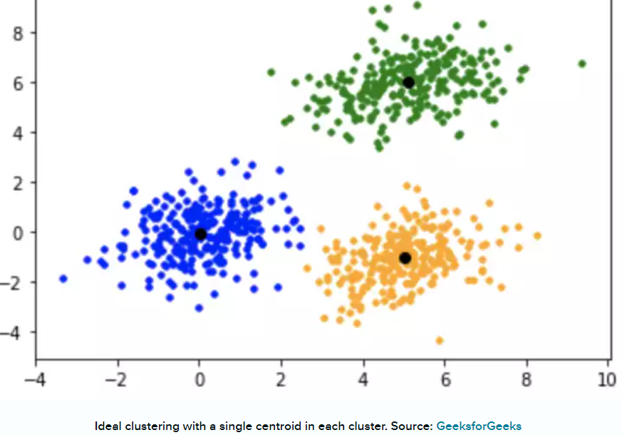
Clustering Algorithms
K-Means Clustering
In K-means clustering, data is grouped in terms of characteristics and similarities. It partitions the data set such that-
Each data point belongs to a cluster with the nearest mean.
Data points belonging to one cluster have high degree of similarity.
Data points belonging to different clusters have high degree of dissimilarity.
K is a letter that represents the number of clusters. For example, if K=3, then the number of desired clusters is 3. If K=10, then the number of desired clusters is 10.
It puts the data points into the predefined number of clusters K.
Each data item then gets assigned to the nearest cluster center, called centroids (black dots in the picture). The latter act as data accumulation areas.
The procedure of clustering may be repeated several times until the clusters are well-defined.
To calculate the similarity, we can use the Euclidean distance, Manhattan distance, Hamming distance, Cosine distance as measurement.
Notes:
In this algorithm, data is divided into a specific number of groups or clusters. It is achieved by minimizing the total squared distances between the data points and the centers of each cluster.

Slide 3
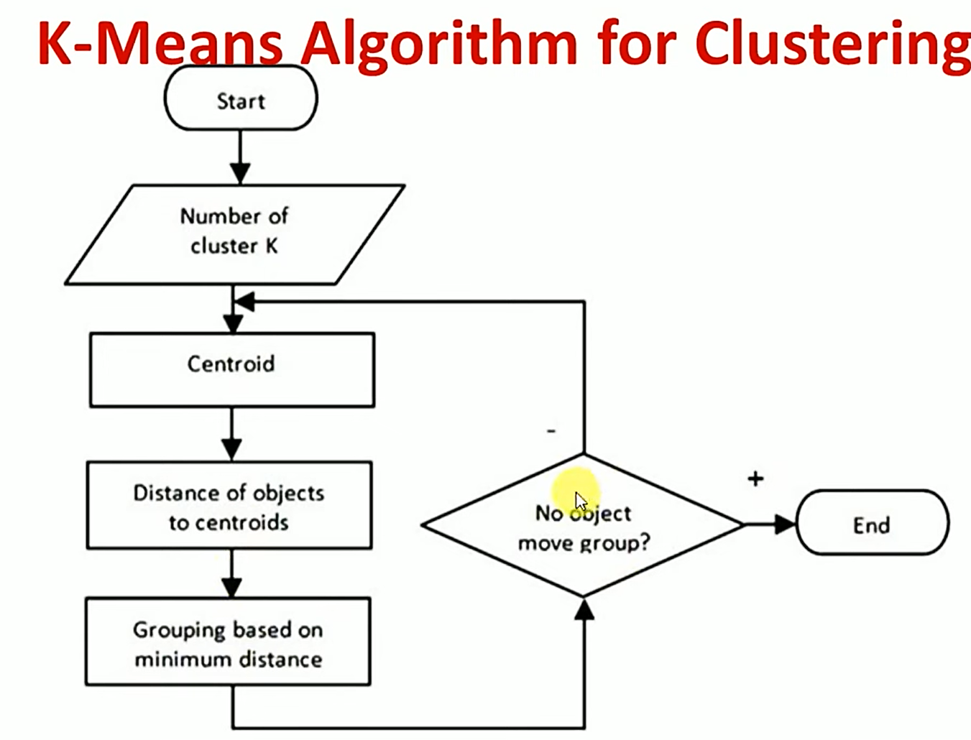

Slide 4
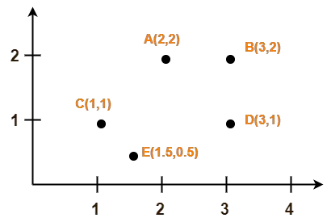
K-MEANS CLUSTERING ALGORITHM
Problem:
Use K-Means Algorithm to create two clusters-

Slide 5
K-MEANS CLUSTERING ALGORITHM
Solution-
Assume A(2, 2) and C(1, 1) are centers of the two clusters.
Iteration-01:
We calculate the distance of each point from each of the center of the two clusters.
The distance is calculated by using the euclidean distance formula.
The following illustration shows the calculation of distance between point A(2, 2) and each of the center of the two clusters-
Calculating Distance Between A(2, 2) and C1(2, 2)-
Ρ(A, C1)
= sqrt [ (x2 – x1)² + (y2 – y1)² ]
= sqrt [ (2 – 2)² + (2 – 2)² ]
= sqrt [ 0 + 0 ]
= 0
Calculating Distance Between A(2, 2) and C2(1, 1)-
Ρ(A, C2)
= sqrt [ (x2 – x1)² + (y2 – y1)² ]
= sqrt [ (1 – 2)² + (1 – 2)² ]
= sqrt [ 1 + 1 ]
= sqrt [ 2 ]
= 1.41

Slide 6
K-MEANS CLUSTERING ALGORITHM
In the similar manner, we calculate the distance of other points from each of the center of the two clusters.
Next, We draw a table showing all the results.
Using the table, we decide which point belongs to which cluster.
The given point belongs to that cluster whose center is nearest to it.

Slide 7
K-MEANS CLUSTERING ALGORITHM
iteration-01
From here, New clusters are-
Cluster-01:
First cluster contains points-
A(2, 2)
B(3, 2)
D(3, 1)
Cluster-02:
Second cluster contains points-
C(1, 1)
E(1.5, 0.5)
Now,
We re-compute the new clusters center.
The new cluster center is computed by taking mean of all the points contained in that cluster.
Given Points | Distance from center (2, 2) of Cluster-01 | Distance from center (1, 1) of Cluster-02 | Point belongs to Cluster
A(2, 2) | 0 | 1.41 | C1
B(3, 2) | 1 | 2.24 | C1
C(1, 1) | 1.41 | 0 | C2
D(3, 1) | 1.41 | 2 | C1
E(1.5, 0.5) | 1.58 | 0.71 | C2

Slide 8
K-MEANS CLUSTERING ALGORITHM
For Cluster-01:
Center of Cluster-01
= ((2 + 3 + 3)/3, (2 + 2 + 1)/3)
= (2.67, 1.67)
For Cluster-02:
Center of Cluster-02
= ((1 + 1.5)/2, (1 + 0.5)/2)
= (1.25, 0.75)
This is completion of Iteration-01.
Next, we go to iteration-02, iteration-03 and so on until the centers do not change anymore.
Notes:
https://www.gatevidyalay.com/k-means-clustering-algorithm-example/

Slide 9
K-MEANS CLUSTERING ALGORITHM
Given Points | Distance from center (2.67, 1.67) of Cluster-01 | Distance from center (1.25, 0.75) of Cluster-02 | Point belongs to Cluster
A(2, 2) | 0.746 | 1.457 | C1
B(3, 2) | 0.467 | 2.15 | C1
C(1, 1) | 1.799 | 0.3535 | C2
D(3, 1) | 0.746 | 1.7748 | C1
E(1.5, 0.5) | 1.654 | 0.3535 | C2
iteration-02
Cluster-01:
First cluster contains points-
A(2, 2)
B(3, 2)
D(3, 1)
Cluster-02:
Second cluster contains points-
C(1, 1)
E(1.5, 0.5)
For Cluster-01:
Center of Cluster-01
= ((2 + 3 + 3)/3, (2 + 2 + 1)/3)
= (2.67, 1.67)
For Cluster-02:
Center of Cluster-02
= ((1 + 1.5)/2, (1 + 0.5)/2)
= (1.25, 0.75)
This is completion of Iteration-02.
The centers do not change anymore.
A(2, 2), B(3, 2), D(3, 1) points belong to C1
C(1, 1), E(1.5, 0.5)points belong to C2
Notes:
https://www.gatevidyalay.com/k-means-clustering-algorithm-example/

Slide 10
Advantages-
K-Means Clustering Algorithm offers the following advantages-
Point-01:
It is relatively efficient with time complexity O(nkt) where-
n = number of instances
k = number of clusters
t = number of iterations
Point-02:
It often terminates at local optimum.
Techniques such as Simulated Annealing or Genetic Algorithms may be used to find the global optimum.
Disadvantages-
K-Means Clustering Algorithm has the following disadvantages-
It requires to specify the number of clusters (k) in advance.
It can not handle noisy data and outliers.
It is not suitable to identify clusters with non-convex shapes.

Slide 11
PRACTICE PROBLEMS BASED ON K-MEANS CLUSTERING ALGORITHM
Problem-01:
Cluster the following eight points (with (x, y) representing locations) into three clusters:
A1(2, 10), A2(2, 5), A3(8, 4), A4(5, 8), A5(7, 5), A6(6, 4), A7(1, 2), A8(4, 9)
Initial cluster centers are: A1(2, 10), A4(5, 8) and A7(1, 2).
The distance function between two points a = (x1, y1) and b = (x2, y2) is defined as-
Ρ(a, b) = |x2 – x1| + |y2 – y1|
Use K-Means Algorithm to find the three cluster centers after the second iteration.
Solution-
We follow the above discussed K-Means Clustering Algorithm-
Iteration-01:
We calculate the distance of each point from each of the center of the three clusters.
The distance is calculated by using the given distance function.

Slide 12
K-MEANS CLUSTERING ALGORITHM
The following illustration shows the calculation of distance between point A1(2, 10) and each of the center of the three clusters-
Calculating Distance Between A1(2, 10) and C1(2, 10)-
Ρ(A1, C1)
= |x2 – x1| + |y2 – y1|
= |2 – 2| + |10 – 10|
= 0
Calculating Distance Between A1(2, 10) and C2(5, 8)-
Ρ(A1, C2)
= |x2 – x1| + |y2 – y1|
= |5 – 2| + |8 – 10|
= 3 + 2
= 5

Slide 13
K-MEANS CLUSTERING ALGORITHM
Calculating Distance Between A1(2, 10) and C3(1, 2)-
Ρ(A1, C3)
= |x2 – x1| + |y2 – y1|
= |1 – 2| + |2 – 10|
= 1 + 8
= 9

Slide 14
K-MEANS CLUSTERING ALGORITHM
In the similar manner, we calculate the distance of other points from each of the center of the three clusters.
Next,
We draw a table showing all the results.
Using the table, we decide which point belongs to which cluster.
The given point belongs to that cluster whose center is nearest to it.
From here, New clusters are-
Cluster-01:
First cluster contains points-
A1(2, 10)
Given Points | Distance from center (2, 10) of Cluster-01 | Distance from center (5, 8) of Cluster-02 | Distance from center (1, 2) of Cluster-03 | Point belongs to Cluster
A1(2, 10) | 0 | 5 | 9 | C1
A2(2, 5) | 5 | 6 | 4 | C3
A3(8, 4) | 12 | 7 | 9 | C2
A4(5, 8) | 5 | 0 | 10 | C2
A5(7, 5) | 10 | 5 | 9 | C2
A6(6, 4) | 10 | 5 | 7 | C2
A7(1, 2) | 9 | 10 | 0 | C3
A8(4, 9) | 3 | 2 | 10 | C2

Slide 15
K-MEANS CLUSTERING ALGORITHM
Using Euclidean distance
In the similar manner, we calculate the distance of other points from each of the center of the three clusters.
Next,
We draw a table showing all the results.
Using the table, we decide which point belongs to which cluster.
The given point belongs to that cluster whose center is nearest to it.
From here, New clusters are-
Cluster-01:
First cluster contains points-
A1(2, 10)
Given Points | Distance from center (2, 10) of Cluster-01 | Distance from center (5, 8) of Cluster-02 | Distance from center (1, 2) of Cluster-03 | Point belongs to Cluster
A1(2, 10) | 0 | 3.605 | 8.06 | C1
A2(2, 5) | 5 | 4.24 | 3.162 | C3
A3(8, 4) | 8.48 | 5 | 7.28 | C2
A4(5, 8) | 3.605 | 0 | 7.21 | C2
A5(7, 5) | 7.07 | 3.605 | 6.708 | C2
A6(6, 4) | 7.21 | 4.123 | 5.385 | C2
A7(1, 2) | 8.06 | 7.21 | 0 | C3
A8(4, 9) | 2.23 | 1.414 | 7.615 | C2

Slide 16
K-MEANS CLUSTERING ALGORITHM
Cluster-02:
Second cluster contains points-
A3(8, 4)
A4(5, 8)
A5(7, 5)
A6(6, 4)
A8(4, 9)

Slide 17
K-MEANS CLUSTERING ALGORITHM
Cluster-03:
Third cluster contains points-
A2(2, 5)
A7(1, 2)
Now,
We re-compute the new cluster clusters.
The new cluster center is computed by taking mean of all the points contained in that cluster.
For Cluster-01:
We have only one point A1(2, 10) in Cluster-01.
So, cluster center remains the same.

Slide 18
K-MEANS CLUSTERING ALGORITHM
For Cluster-02:
Center of Cluster-02
= ((8 + 5 + 7 + 6 + 4)/5, (4 + 8 + 5 + 4 + 9)/5)
= (6, 6)
For Cluster-03:
Center of Cluster-03
= ((2 + 1)/2, (5 + 2)/2)
= (1.5, 3.5)
This is completion of Iteration-01.

Slide 19
K-MEANS CLUSTERING ALGORITHM
Iteration-02:
We calculate the distance of each point from each of the center of the three clusters.
The distance is calculated by using the given distance function.
The following illustration shows the calculation of distance between point A1(2, 10) and each of the center of the three clusters-
Calculating Distance Between A1(2, 10) and C1(2, 10)-
Ρ(A1, C1)
= |x2 – x1| + |y2 – y1|
= |2 – 2| + |10 – 10|
= 0

Slide 20
K-MEANS CLUSTERING ALGORITHM
Calculating Distance Between A1(2, 10) and C2(6, 6)-
Ρ(A1, C2)
= |x2 – x1| + |y2 – y1|
= |6 – 2| + |6 – 10|
= 4 + 4
= 8

Slide 21
K-MEANS CLUSTERING ALGORITHM
Calculating Distance Between A1(2, 10) and C3(1.5, 3.5)-
Ρ(A1, C3)
= |x2 – x1| + |y2 – y1|
= |1.5 – 2| + |3.5 – 10|
= 0.5 + 6.5
= 7
In the similar manner, we calculate the distance of other points from each of the center of the three clusters.
Next,
We draw a table showing all the results.
Using the table, we decide which point belongs to which cluster.
The given point belongs to that cluster whose center is nearest to it.

Slide 22
K-MEANS CLUSTERING ALGORITHM
From here, New clusters are-
Cluster-01:
First cluster contains points-
A1(2, 10)
A8(4, 9)
Cluster-02:
Second cluster contains points-
A3(8, 4)
A4(5, 8)
A5(7, 5)
A6(6, 4)
Given Points | Distance from center (2, 10) of Cluster-01 | Distance from center (6, 6) of Cluster-02 | Distance from center (1.5, 3.5) of Cluster-03 | Point belongs to Cluster
A1(2, 10) | 0 | 8 | 7 | C1
A2(2, 5) | 5 | 5 | 2 | C3
A3(8, 4) | 12 | 4 | 7 | C2
A4(5, 8) | 5 | 3 | 8 | C2
A5(7, 5) | 10 | 2 | 7 | C2
A6(6, 4) | 10 | 2 | 5 | C2
A7(1, 2) | 9 | 9 | 2 | C3
A8(4, 9) | 3 | 5 | 8 | C1

Slide 23
K-MEANS CLUSTERING ALGORITHM
Using Euclidean distance
From here, New clusters are-
Cluster-01:
First cluster contains points-
A1(2, 10)
A8(4, 9)
Cluster-02:
Second cluster contains points-
A3(8, 4)
A4(5, 8)
A5(7, 5)
A6(6, 4)
Given Points | Distance from center (2, 10) of Cluster-01 | Distance from center (6, 6) of Cluster-02 | Distance from center (1.5, 3.5) of Cluster-03 | Point belongs to Cluster
A1(2, 10) | 0 | 5.65 | 6.519 | C1
A2(2, 5) | 5 | 4.123 | 1.581 | C3
A3(8, 4) | 8.48 | 2.828 | 6.519 | C2
A4(5, 8) | 3.605 | 2.236 | 5.7 | C2
A5(7, 5) | 7.07 | 1.414 | 5.7 | C2
A6(6, 4) | 7.21 | 2 | 4.527 | C2
A7(1, 2) | 8.06 | 6.403 | 1.581 | C3
A8(4, 9) | 2.23 | 3.605 | 6.041 | C1

Slide 24
K-MEANS CLUSTERING ALGORITHM
Cluster-03:
Third cluster contains points-
A2(2, 5)
A7(1, 2)
Now,
We re-compute the new cluster clusters.
The new cluster center is computed by taking mean of all the points contained in that cluster.

Slide 25
K-MEANS CLUSTERING ALGORITHM
For Cluster-01:
Center of Cluster-01
= ((2 + 4)/2, (10 + 9)/2)
= (3, 9.5)
For Cluster-02:
Center of Cluster-02
= ((8 + 5 + 7 + 6)/4, (4 + 8 + 5 + 4)/4)
= (6.5, 5.25)

Slide 26
K-MEANS CLUSTERING ALGORITHM
For Cluster-03:
Center of Cluster-03
= ((2 + 1)/2, (5 + 2)/2)
= (1.5, 3.5)
This is completion of Iteration-02.
After second iteration, the center of the three clusters are-
C1(3, 9.5)
C2(6.5, 5.25)
C3(1.5, 3.5)

Slide 27
Hierarchical Clustering in Machine Learning
Hierarchical clustering is another unsupervised machine learning algorithm, which is used to group the unlabeled datasets into a cluster and also known as hierarchical cluster analysis or HCA.
In this algorithm, we develop the hierarchy of clusters in the form of a tree, and this tree-shaped structure is known as the dendrogram.
Sometimes the results of K-means clustering and hierarchical clustering may look similar, but they both differ depending on how they work. As there is no requirement to predetermine the number of clusters as we did in the K-Means algorithm.

Slide 28
The hierarchical clustering technique has two approaches:
Agglomerative: Agglomerative is a bottom-up approach, in which the algorithm starts with taking all data points as single clusters and merging them until one cluster is left.
Divisive: Divisive algorithm is the reverse of the agglomerative algorithm as it is a top-down approach.
Why hierarchical clustering?
As we already have other clustering algorithms such as K-Means Clustering, then why we need hierarchical clustering? So, as we have seen in the K-means clustering that there are some challenges with this algorithm, which are a predetermined number of clusters, and it always tries to create the clusters of the same size. To solve these two challenges, we have for the hierarchical clustering algorithm because, in this algorithm, we don't need to have knowledge about the predefined number of clusters.

Slide 29
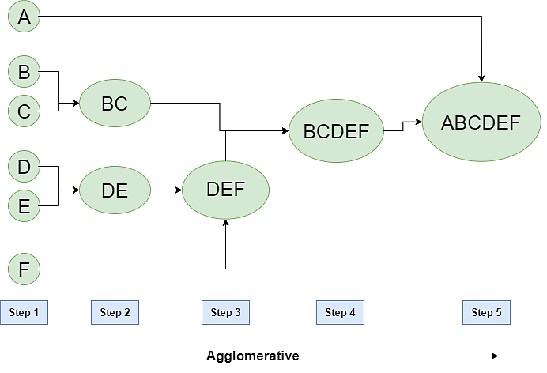
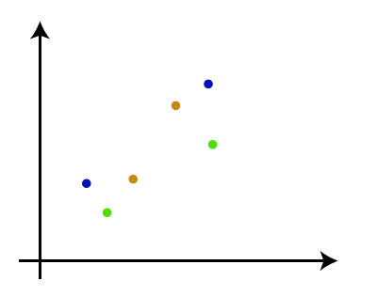
Agglomerative Hierarchical clustering
The agglomerative hierarchical clustering algorithm is a popular example of HCA. To group the datasets into clusters, it follows the bottom-up approach. It means, this algorithm considers each dataset as a single cluster at the beginning, and then start combining the closest pair of clusters together. It does this until all the clusters are merged into a single cluster that contains all the datasets.
This hierarchy of clusters is represented in the form of the dendrogram.
How the Agglomerative Hierarchical clustering Work?
The working of the AHC algorithm can be explained using the below steps:
Step-1: Create each data point as a single cluster. Let's say there are N data points, so the number of clusters will also be N.

Slide 30
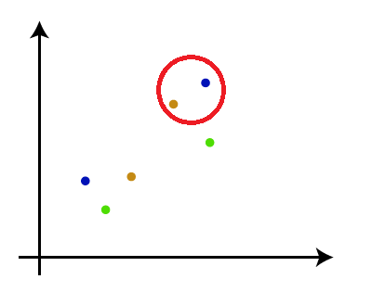
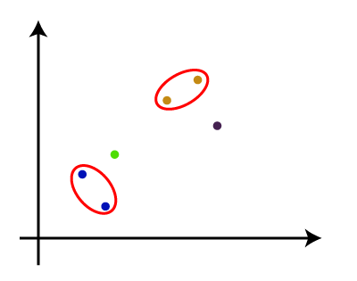
Step-2: Take two closest data points or clusters and merge them to form one cluster. So, there will now be N-1 clusters.
Step-3: Again, take the two closest clusters and merge them together to form one cluster. There will be N-2 clusters.

Slide 31
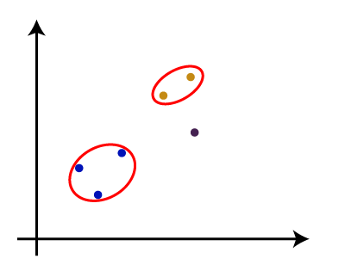
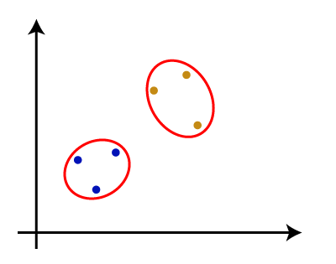
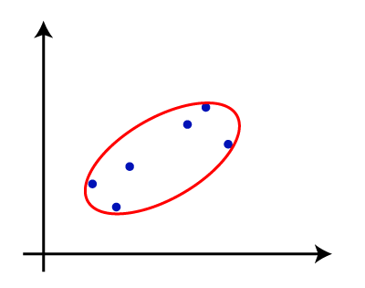
Step-4: Repeat Step 3 until only one cluster left. So, we will get the following clusters. Consider the below images:
Step-5: Once all the clusters are combined into one big cluster, develop the dendrogram to divide the clusters as per the problem.

Slide 32
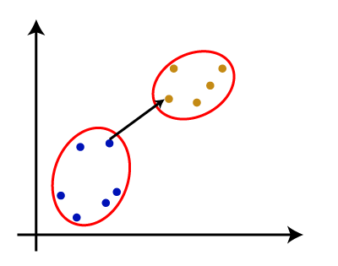
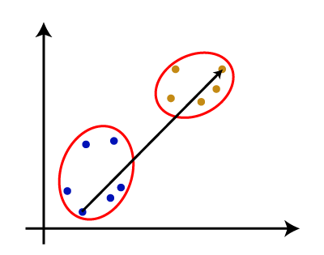
Measure for the distance between two clusters
As we have seen, the closest distance between the two clusters is crucial for the hierarchical clustering. There are various ways to calculate the distance between two clusters, and these ways decide the rule for clustering. These measures are called Linkage methods. Some of the popular linkage methods are given below:
Single Linkage: It is the Shortest Distance between the closest points of the clusters. Consider the below image:
Complete Linkage: It is the farthest distance between the two points of two different clusters. It is one of the popular linkage methods as it forms tighter clusters than single-linkage.

Slide 33
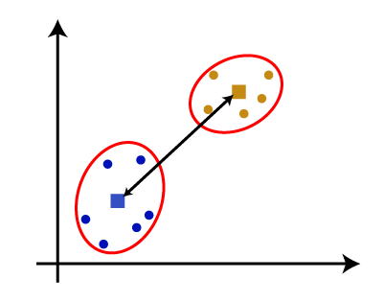
Average Linkage: It is the linkage method in which the distance between each pair of datasets is added up and then divided by the total number of datasets to calculate the average distance between two clusters. It is also one of the most popular linkage methods.
Centroid Linkage: It is the linkage method in which the distance between the centroid of the clusters is calculated. Consider the below image:

Slide 34
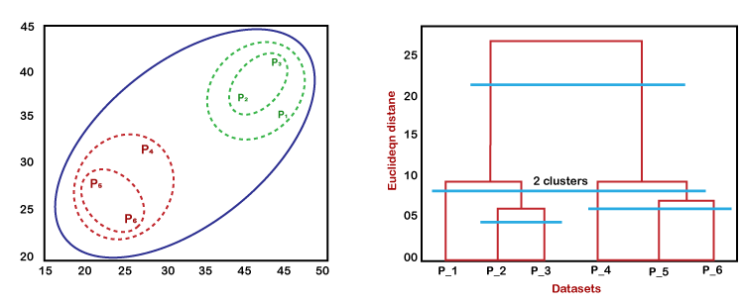
Working of Dendrogram in Hierarchical clustering
The dendrogram is a tree-like structure that is mainly used to store each step as a memory that the HC algorithm performs. In the dendrogram plot, the Y-axis shows the Euclidean distances between the data points, and the x-axis shows all the data points of the given dataset.
The working of the dendrogram can be explained using the below diagram:
In the above diagram, the left part is showing how clusters are created in agglomerative clustering, and the right part is showing the corresponding dendrogram.

Slide 35
As we have discussed above, firstly, the data points P2 and P3 combine together and form a cluster, correspondingly a dendrogram is created, which connects P2 and P3 with a rectangular shape. The hight is decided according to the Euclidean distance between the data points.
In the next step, P5 and P6 form a cluster, and the corresponding dendrogram is created. It is higher than of previous, as the Euclidean distance between P5 and P6 is a little bit greater than the P2 and P3.
Again, two new dendrograms are created that combine P1, P2, and P3 in one dendrogram, and P4, P5, and P6, in another dendrogram.
At last, the final dendrogram is created that combines all the data points together.

Slide 36
Now we will look into the variants of Agglomerative methods:
1. Agglomerative Algorithm: Single Link
Single-nearest distance or single linkage is the agglomerative method that uses the distance between the closest members of the two clusters. We will now solve a problem to understand it better:
Question. Find the clusters using a single link technique. Use Euclidean distance and draw the dendrogram.
Sample No. | X | Y
P1 | 0.40 | 0.53
P2 | 0.22 | 0.38
P3 | 0.35 | 0.32
P4 | 0.26 | 0.19
P5 | 0.08 | 0.41
P6 | 0.45 | 0.30

Slide 37
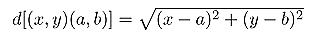
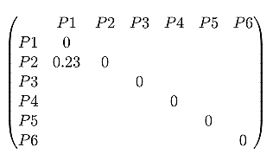
Solution:
Step 1: Compute the distance matrix by:
So we have to find the Euclidean distance between each and every points, say we first find the euclidean distance between P1 and P2
So the DISTANCE MATRIX will look like this:

Slide 38
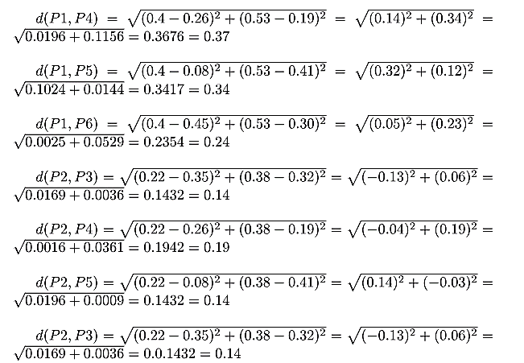
Similarly, find the Euclidean distance for every point. But there is one point to focus on that the diagonal of the above distance matrix is a special point for us. The distance above and below the diagonal will be same. For eg: d(P2, P5) is equivalent to d(P5, P2). So we will find the distance of the below section of the matrix.

Slide 39
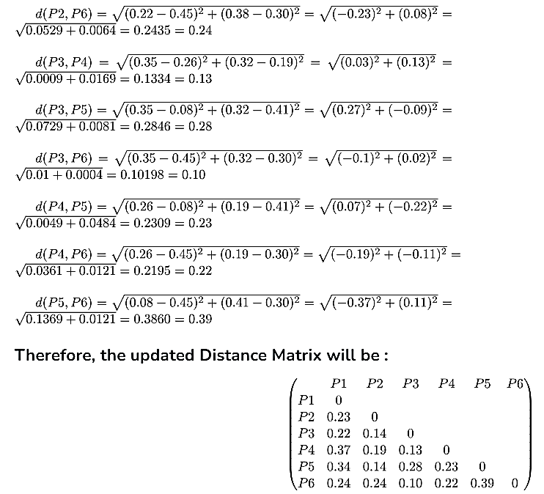
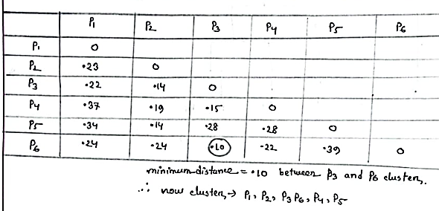
Correction
0.15
0.28

Slide 40
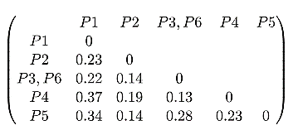
Step 2: Merging the two closest members of the two clusters and finding the minimum element in distance matrix. Here the minimum value is 0.10 and hence we combine P3 and P6 (as 0.10 came in the P6 row and P3 column). Now, form clusters of elements corresponding to the minimum value and update the distance matrix. To update the distance matrix:
min ((P3,P6), P1) = min ((P3,P1), (P6,P1)) = min (0.22,0.24) = 0.22
min ((P3,P6), P2) = min ((P3,P2), (P6,P2)) = min (0.14,0.24) = 0.14
min ((P3,P6), P4) = min ((P3,P4), (P6,P4)) = min (0.13,0.22) = 0.13
min ((P3,P6), P5) = min ((P3,P5), (P6,P5)) = min (0.28,0.39) = 0.28
Now we will update the Distance Matrix:
0.15
0.28

Slide 41
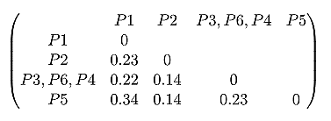
Now we will repeat the same process. Merge two closest members of the two clusters and find the minimum element in distance matrix. The minimum value is 0.13 and hence we combine P3, P6 and P4. Now, form the clusters of elements corresponding to the minimum values and update the Distance matrix. In order to find, what we have to update in distance matrix,
min (((P3,P6) P4), P1) = min (((P3,P6), P1), (P4,P1)) = min (0.22,0.37) = 0.22
min (((P3,P6), P4), P2) = min (((P3,P6), P2), (P4,P2)) = min (0.14,0.19) = 0.14
min (((P3,P6), P4), P5) = min (((P3,P6), P5), (P4,P5)) = min (0.28,0.23) = 0.23
Now we will update the Distance Matrix:

Slide 42
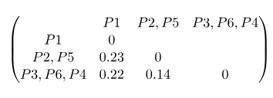
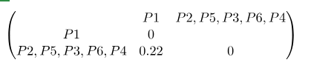
Again repeating the same process: The minimum value is 0.14 and hence we combine P2 and P5. Now, form cluster of elements corresponding to minimum value and update the distance matrix. To update the distance matrix:
min ((P2,P5), P1) = min ((P2,P1), (P5,P1)) = min (0.23, 0.34) = 0.23
min ((P2,P5), (P3,P6,P4)) = min ((P3,P6,P4), (P3,P6,P4)) = min (0.14. 0.23) = 0.14
Update Distance Matrix will be:
Again repeating the same process: The minimum value is 0.14 and hence we combine P2,P5 and P3,P6,P4. Now, form cluster of elements corresponding to minimum value and update the distance matrix. To update the distance matrix:
min ((P2,P5,P3,P6,P4), P1) = min ((P2,P5), P1), ((P3,P6,P4), P1)) = min (0.23, 0.22) = 0.22
Updated Distance Matrix will be:

Slide 43
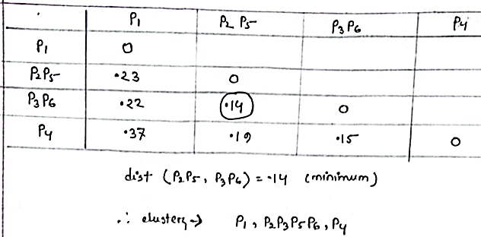
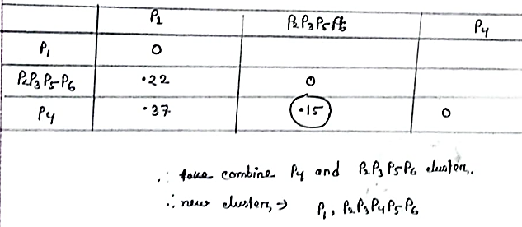
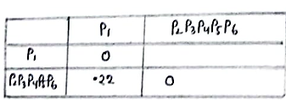
Correction

Slide 44
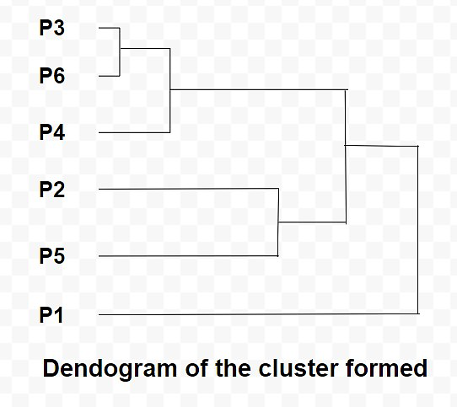
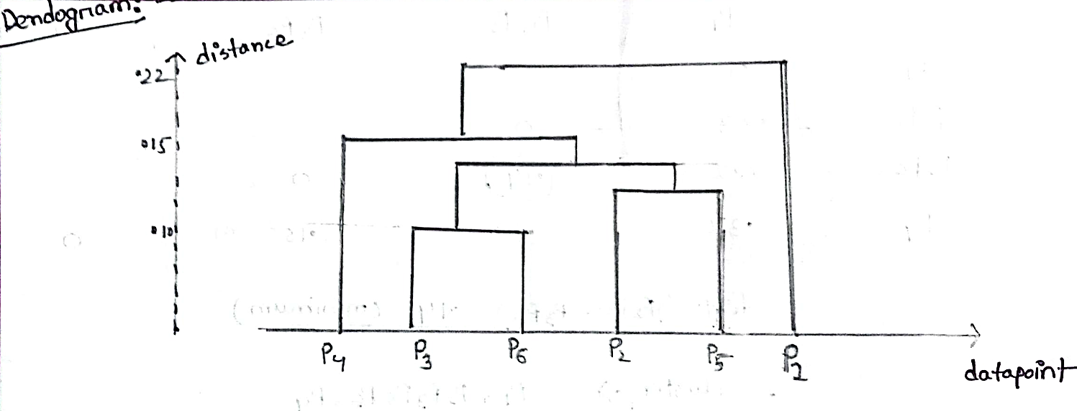
So now we have reached to the solution finally, the dendrogram for those question will be as follows:
Correction

Slide 45
2. Agglomerative Algorithm: Complete Link
In this algorithm, complete farthest distance or complete linkage is the agglomerative method that uses the distance between the members that are the farthest apart.
Question. For the given set of points, identify clusters using the complete link agglomerative clustering
Sample No | X | Y
P1 | 1 | 1
P2 | 1.5 | 1.5
P3 | 5 | 5
P4 | 3 | 4
P5 | 4 | 4
P6 | 3 | 3.5

Slide 46
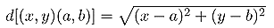
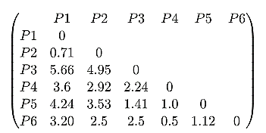
Step 1: Compute the distance matrix by:
So we have to find the euclidean distance between each and every point, say we first find the euclidean distance between P1 and P2. (FORMULA FOR CALCULATING THE DISTANCE IS SAME AS ABOVE)
Say the Distance Matrix for some points is :
Step 2: Merging the two closest members of the two clusters and finding the minimum element in distance matrix. So, the minimum value is 0.5 and hence we combine P4 and P6. To update the distance matrix,
max (d(P4,P6), P1) = max (d(P4,P1), d(P6,P1)) = max (3.6, 3.2) = 3.6
max (d(P4,P6), P2) = max (d(P4,P2), d(P6,P2)) = max (2.92, 2.5) = 2.92
max (d(P4,P6), P3) = max (d(P4,P3), d(P6,P3)) = max (2.24, 2.5) = 2.5
max (d(P4,P6), P5) = max (d(P4,P5), d(P6,P5)) = max (1.0, 1.12) = 1.12

Slide 47
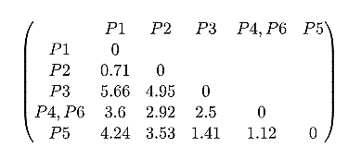
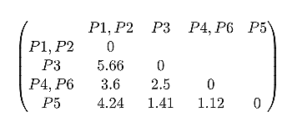
Updated distance matrix is:
Again, merging the two closest members of the two clusters and finding the minimum element in distance matrix. We get the minimum value as 0.71 and hence we combine P1 and P2. To update the distance matrix,
max (d(P1, P2), P3) = max (d(P1, P3), d(P2, P3)) = max (5.66, 4.95) = 5.66
max (d(P1,P2), (P4,P6)) = max (d(P1, P4, P6), d(P2, P4, P6)) = max (3.6, 2.92) = 3.6
max (d(P1,P2), P5) = max (d(P1, P5), d(P2, P5)) = max (4.24, 3.53) = 4.24
Updated distance matrix is:

Slide 48
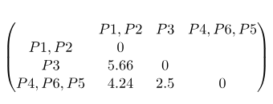
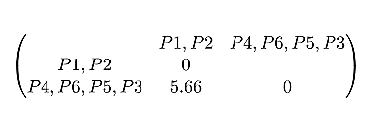
Again, merging the two closest members of the two clusters and finding the minimum element in distance matrix. We get the minimum value as 1.12 and hence we combine P4, P6 and P5. To update the distance matrix,
max (d(P4,P6,P5), (P1,P2)) = max (d(P4,P6,P1,P2), d(P5,P1,P2)) = max (3.6, 4.24) = 4.24
max (d(P4,P6,P5), P3) = max (d(P4,P6,P3), d(P5, P3)) = max (2.5, 1.41) = 2.5
Updated distance matrix is:
Again, merging the two closest members of the two clusters and finding the minimum element in distance matrix. We get the minimum value as 2.5 and hence combine P4,P6,P5 and P3. to update the distance matrix,
min (d(P4,P6,P5,P3), (P1,P2)) = max (d(P4,P6,P5,P1,P2), d(P3,P1,P2)) = max (4.24, 5.66) = 5.66
Updated distance matrix is:

Slide 49
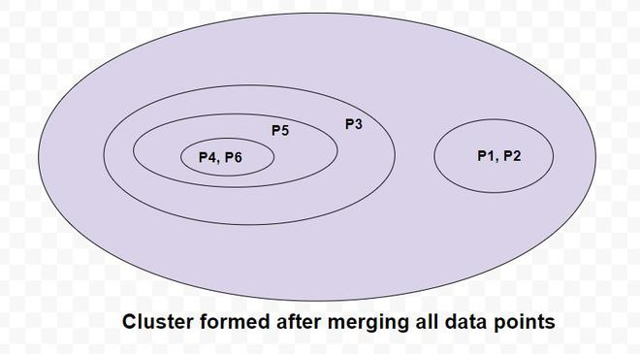
So now we have reached to the solution finally, the dendrogram for those question will be as follows:

Slide 50
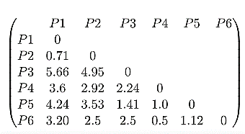
Agglomerative Algorithm: Average Link
Average-average distance or average linkage is the method that involves looking at the distances between all pairs and averages all of these distances. This is also called Universal Pair Group Mean Averaging.
Question. For the points given in the previous question, identify clusters using average link agglomerative clustering
Solution:
We have to first find the Distance Matrix, as we have picked the same question the distance matrix will be same as above:

Slide 51
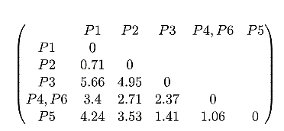
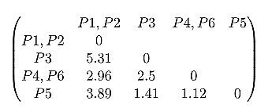
Merging two closest members of the two clusters and finding the minimum elements in distance matrix. We get the minimum value as 0.5 and hence we combine P4 and P6. To update the distance matrix :
average (d(P4,P6), P1) = average (d(P4,P1), d(P6,P1)) = average (3.6, 3.20) = 3.4
average (d(P4,P6), P2) = average (d(P4,P2), d(P6,P2)) = average (2.92, 2.5) = 2.71
average (d(P4,P6), P3) = average (d(P4,P3), d(P6,P3)) = average (2.24, 2.5) = 2.37
average (d(P4,P6), P5) = average (d(P4,P5), d(P6,P5)) = average (1.0, 1.12) = 1.06
Updated distance matrix is:
Merging two closest members of the two clusters and finding the minimum elements in distance matrix. We get the minimum value as 0.71 and hence we combine P1 and P2. To update the distance matrix:
average (d(P1,P2), P3) = average (d(P1,P3), d(P2,P3)) = average (5.66, 4.95) = 5.31
average (d(P1,P2), (P4,P6)) = average (d(P1,P4,P6), d(P2,P4,P6)) = average (3.2, 2.71) = 2.96
average (d(P1,P2), P5) = average (d(P1,P5), d(P2,P5)) = average (4.24, 3.53) = 3.89
Updated distance matrix is:

Slide 52
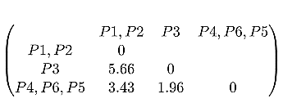
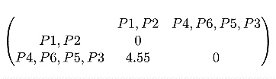
Merging two closest members of the two clusters and finding the minimum elements in distance matrix. We get the minimum value as 1.12 and hence we combine P4,P6 and P5. To update the distance matrix:
average (d(P4,P6,P5), (P1,P2)) = average (d(P4,P6,P1,P2), d(P5,P1,P2)) = average (2.96, 3.89) = 3.43
average (d(P4,P6,P5), P3) = average (d(P4,P6,P3), d(P5,P3)) = average (2.5, 1.41) = 1.96
Updated distance matrix is:
Merging two closest members of the two clusters and finding the minimum elements in distance matrix. We get the minimum value as 1.96 and hence we combine P4,P6,P5 and P3. To update the distance matrix:
average (d(P4,P6,P5,P3), (P1,P2)) = average (d(P4,P6,P5,P1,P2), d(P3,P1P2)) = average (3.43, 5.66) = 4.55
Updated distance matrix is:

Slide 53
So, the final cluster can be drawn is shown as:

Slide 54
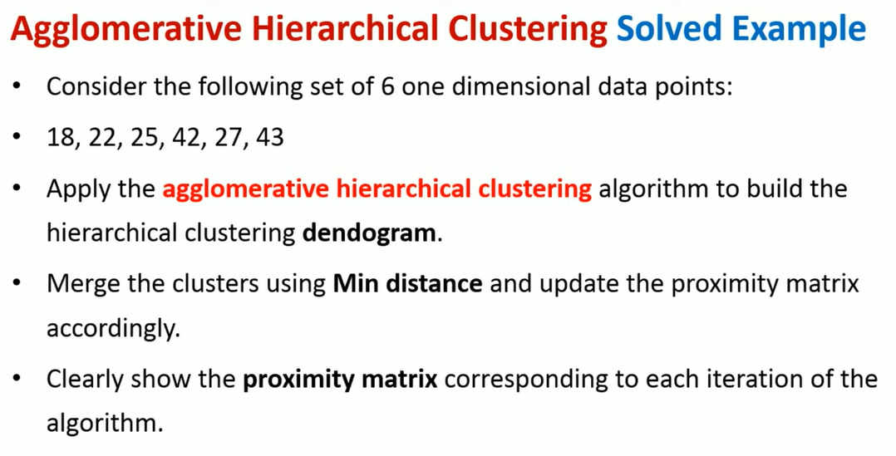

Slide 55
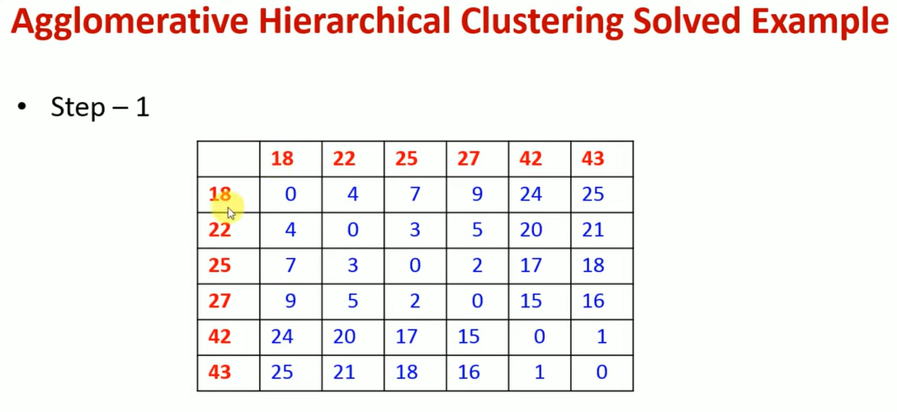
Notes:
https://www.geeksforgeeks.org/agglomerative-methods-in-machine-learning/

Slide 56
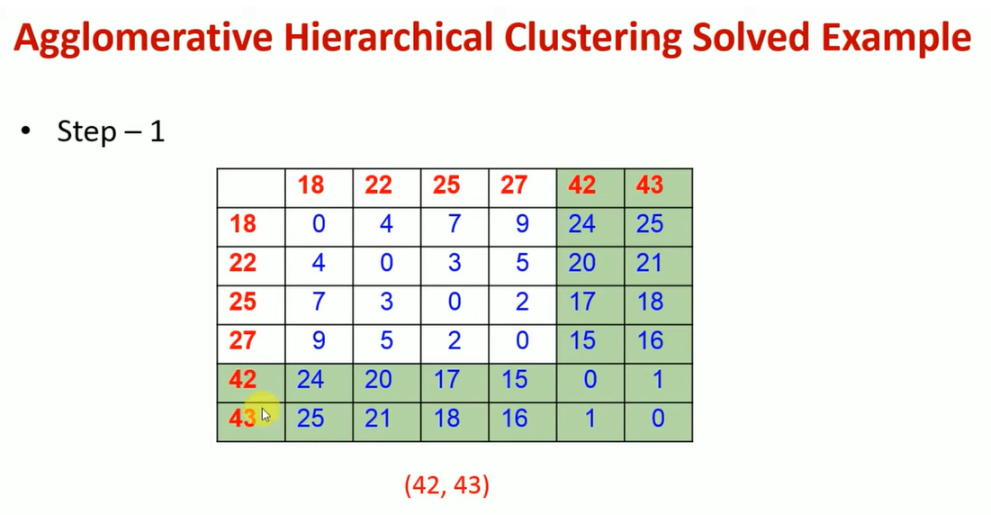
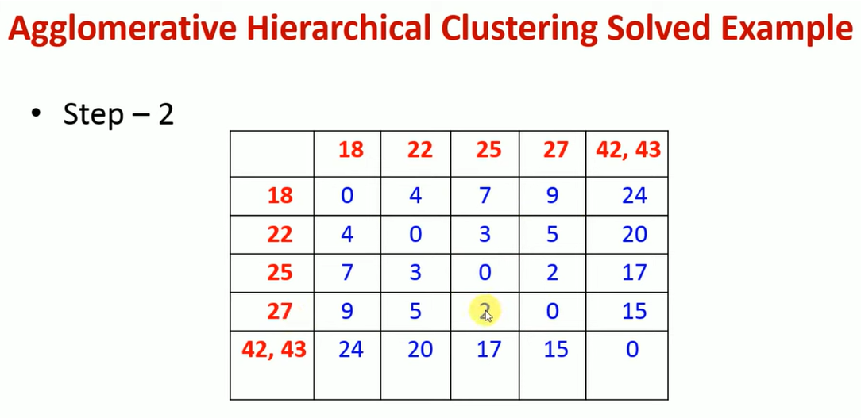
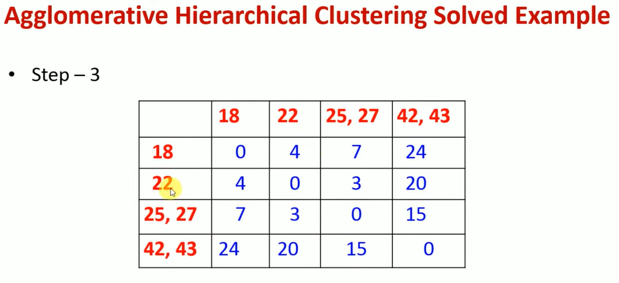
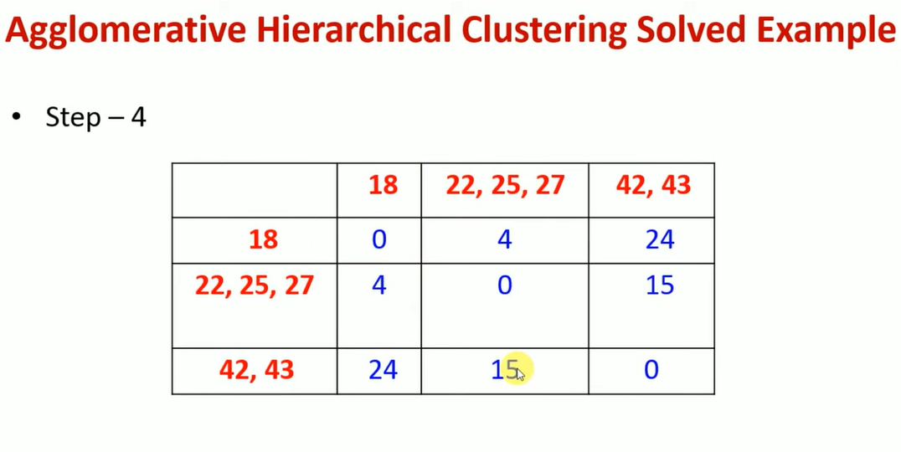
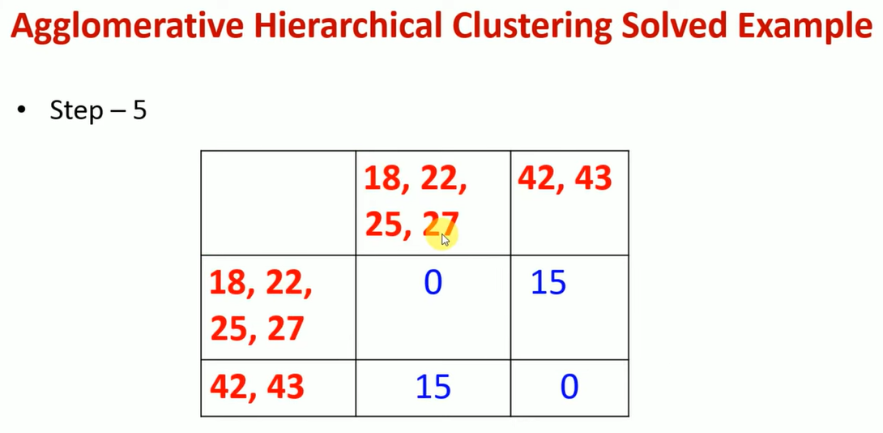
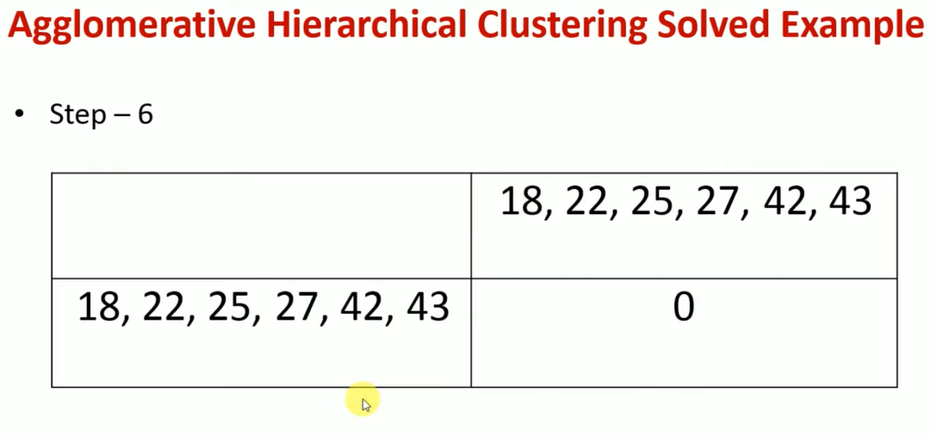

Slide 59
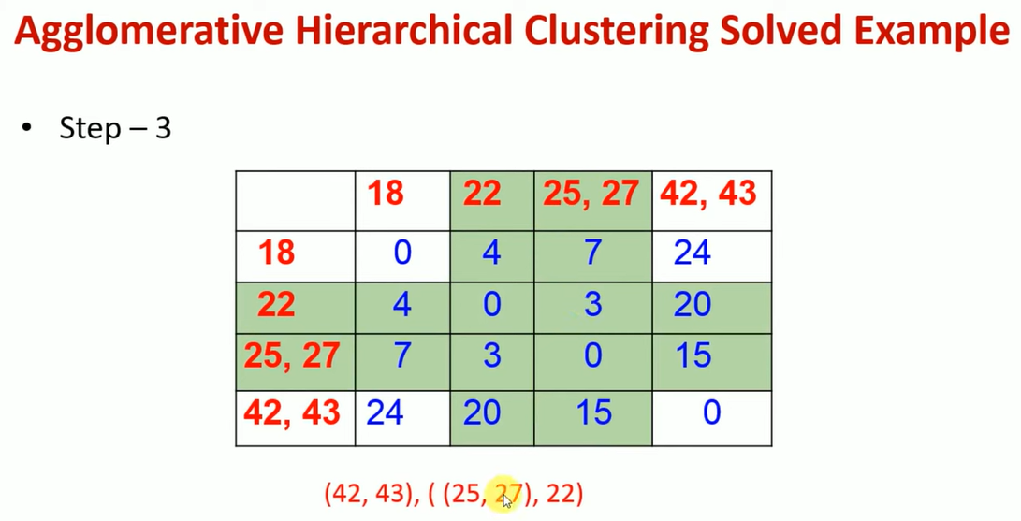

Slide 61
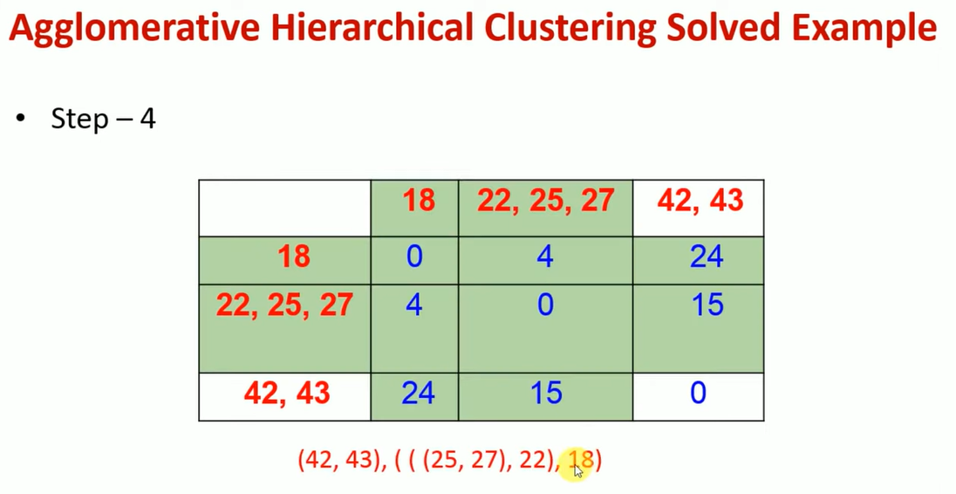

Slide 63


Slide 65

Notes:
https://www.youtube.com/watch?v=oNYtYm0tFso
https://www.youtube.com/watch?v=oNYtYm0tFso

Slide 66
Thank You

